Slide 1
Unsupervised Pre-training for Speech Recognition (wav2vec and 2.0)
성원용

Slide 2
Pre-training
Unsupervised (self-supervised) 방법으로 좋은 embedding 공간을 구축
Text 등 다른 domain에서 이미 많이 사용된다
Word2vec: skip-gram 등을 이용하여 단어의 embedding 을 학습
BERT: transformer 구조를 이용하여 context-aware embedding 을 구축
ViLBERT: Vision을 위한 BERT
BERT 의 영향이 가장 크다

Slide 3
BERT Masked LM training
BERT (Bidirectional Encoder Representations from Transformers)
We use vast amount of plain text (no labeling).
By Pre-training, we get neural networks that can understand text (Sentence embedding, contextualized word-embedding, and so on)
For fine-tuning, we only use a limited amount of labeled data.

Slide 4
Masked LM training (Cloze task)
The final hidden vectors corresponding to the mask tokens are fed into an output softmax over the vocabulary, as in a standard LM. In all of our experiments, we mask 15% of all WordPiece tokens in each sequence at random.
The loss is calculated as the difference between the output probability distributions for each output ‘token’, and the true one-hot encoded labels.
In contrast to denoising auto-encoders (Vincent et al., 2008), we only predict the masked words rather than reconstructing the entire input.

Slide 5
Wav2vec의 목적
종래의 HMM 을 이용한 음성인식
Hand-labeled feature를 이용
Filter-bank, MFCC, +delta, + normalization, +VTLN, +fMLLR
일반적으로 작은 training data
End-to-end 음성인식 방법 (CTC, LAS)
좋은 성능을 위해 많은 labeled data (보통 10,000 시간 단위)
Resource limited language 를 위한 ASR 설계: Unlabeled data 를 이용하는 self-supervised 방법의 pre-training 방법에 의하여 좋은 특징을 추출. 이 추출된 특징을 이용하고 약간의 labeled data를 이용 최적학습

Slide 6
종래의 acoustic model
Feature extractor – Mel frequency filter bank, MFCC (mel-frequency cepstral coefficients) 등 사람(전문가)이 설계한 feature
이 것을 unlabeled data를 이용하여 자동으로 생성하자.
Representation learning

Slide 7
오늘 다룰 논문 3편
Representation learning with contrastive predictive coding (DeepMind)
Wav2vec: Unsupervised pretraining for speech recognition (Facebook AI)
VQ-WAV2VEC: Self-supervised learning of discrete speech representations (Facebook)
Wav2vec 2.0 (Facebook AI)

Slide 8
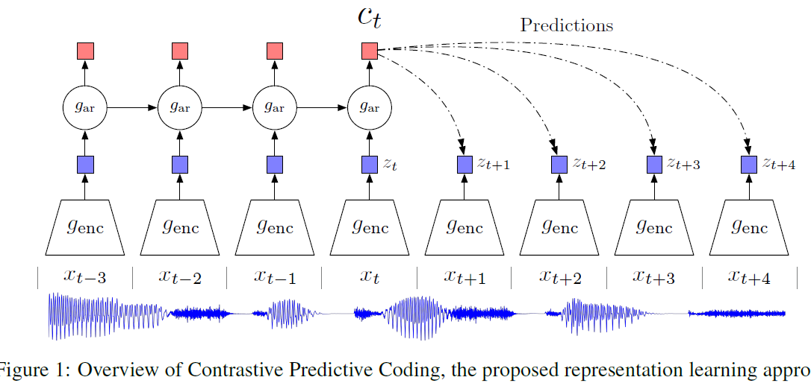
논문 1: Representation learning with contrastive predictive coding (DeepMind)
Self-supervised: Encoder의 출력에서 context를 고려하여 미래의 embedding을 예측, 좋은 feature 를 이용해야 이 것이 가능할 것이다.
입력은 음성 waveform (filter bank 가 아니다)
특징(feature) + linear classifier 에 의한 음소인식

Slide 9
x -> z -> c In text, x is an input text, z is an non-contextualized embedding (word-vector), c is the contextualized vector.
z is the frame-level embedding, c is the multiple frame embedding (contextualized)
How to design z? Maximize the mutual information between x and c

Slide 10

Mutual information
Mutual information is one of many quantities that measures how much one random variables tells us about another.

Slide 11
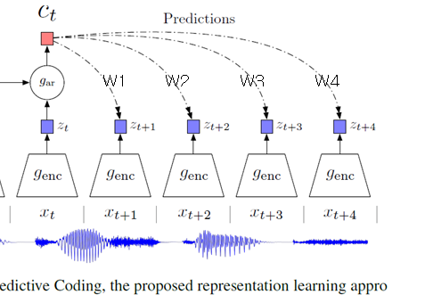

Slide 12
Training for CPC
W_{k}c_{t} 와 z^{T}_{t+K} 의 inner product 를 크게 만듦.

Slide 13
Negative sampling
Softmax computation of large vocabulary problem.
Computing V is too costly, and most of them will have almost zero values. So, sample only K (작은 숫자), and updates only them.
This is approximation, but can speed-up the training process

Slide 14
NCE(Noise Contrastive Estimation)
Estimate the denominator term, and makes it a binary classification problem.
Assume the distribution of negative samples, Q
Sample k negative samples, and estimate the denominator with Q, and makes it a binary classification problem (logistic regression)

Slide 15
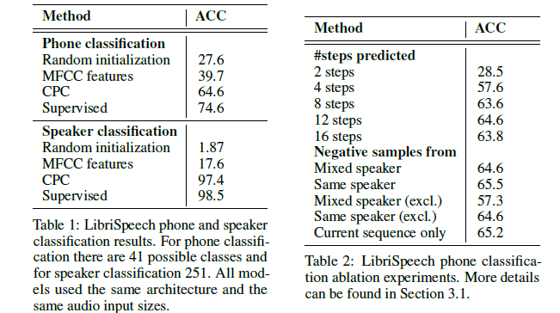
We use five convolutional layers with strides [5, 4, 2, 2, 2], filter-sizes [10, 8, 4, 4, 4] and 512 hidden units with ReLU activations. The total downsampling factor of the network is 160 so that there is a feature vector for every 10ms of speech, which is also the rate of the phoneme sequence labels obtained with Kaldi. We then use a GRU RNN [17] for the autoregressive part of the model, gar with 256 dimensional hidden state. The output of the GRU at every timestep is used as the context c from which we predict 12 timesteps in the future using the contrastive loss

Slide 16
Application of CPC
응용: 음성, 이미지, …
Both z_{t} and c_{t} could be used as representation for downstream tasks.
The autoregressive model output c_{t} can be used if extra context from the past is useful. One such example is speech recognition, where the receptive field of z_{t} might not contain enough information to capture phonetic content. In other cases, where no additional context is required, z_{t} might instead be better. (음성은 당연히 c_{t} 가 더 좋다. c_{t} 는 contextualized feature)

Slide 17
논문 2: Wav2vec network
CPC 구조의 음성인식에의 적용
Unlabeled speech 를 이용한 pre-training
Labeled data (WSJ 등)를 이용한 fine-tuning

Slide 18
Encoder: The output of the encoder is a low frequency feature representation zi, which encodes about 30 ms of 16 kHz of audio and the striding results in representations z_{i} every 10ms.
Context network g : Z -> C to the output of the encoder network to mix multiple latent representations z_{i}. The context network has nine layers with kernel size three and stride one. The total receptive field of the context network is about 210 ms (길이가 길지만 매우 긴 것은 아니다).
The layers in both the encoder and context networks consist of a causal convolution with 512 channels, a group normalization layer and a ReLU nonlinearity.

Slide 19
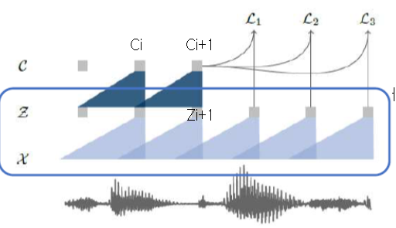
Encoder network (f, feature extraction)
음성의 waveform(파형. X)에서 hidden representation (embedding) Z 로 변환.
One-dimensional convolutional network
5 layers •
Kernel: (10,8,4,4,4)
Strides: (5, 4,2,2,2)

Slide 20
Context network (aggregation)
One-dimensional convolutional network that handles context information of Embedding
9 layers
Kernel: 3
Strides: 1
210ms window in total

Slide 21
Loss and training

Slide 22
음성인식에의 응용
Ci 를 filter-bank 등을 대치하여 acoustic model 을 만드는데 사용한다.

Slide 23
Corpus
For phoneme recognition on TIMIT, the standard train, dev and test split where the training data contains just over three hours of audio data.
Wall Street Journal (WSJ; Woodland et al. (1994)) comprises about 81 hours of transcribed audio data. We train on si284, validate on nov93dev and test on nov92.
Librispeech contains a total of 960 hours of clean and noisy speech for training. For pre-training, we use either the full 81 hours of the WSJ corpus, an 80 hour subset of clean Librispeech, the full 960 hour Librispeech training set or a combination of all of them.
To train the baseline acoustic model we compute 80 log-mel filterbank coefficients for a 25 ms sliding window with stride 10 ms.
Final models are evaluated in terms of both word error rate (WER) and letter error rate (LER).

Slide 24
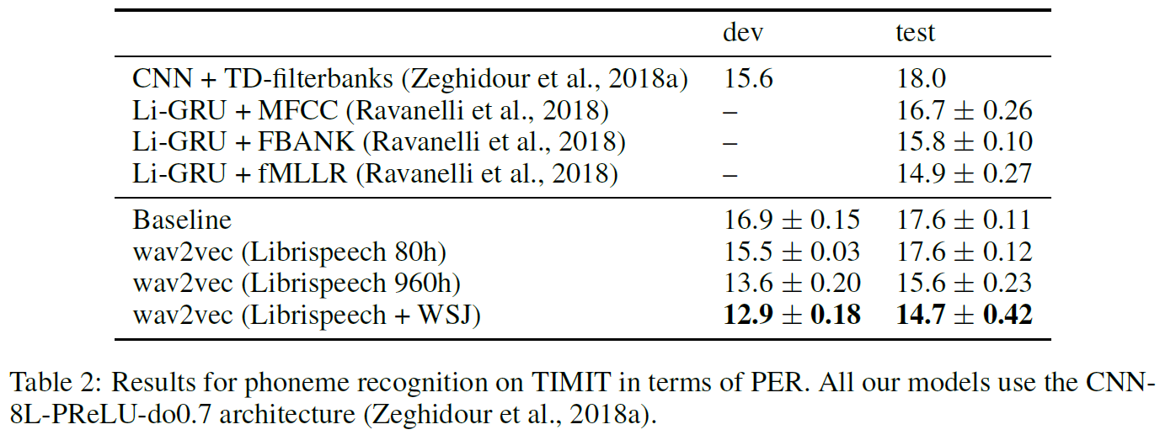
TIMIT fine-tuning (phoneme)
The final representation is projected to a 39- dimensional phoneme probability.

Slide 25
WSJ – 31 grapheme-based (alphabet and repetition, ‘, ., |)

Slide 26
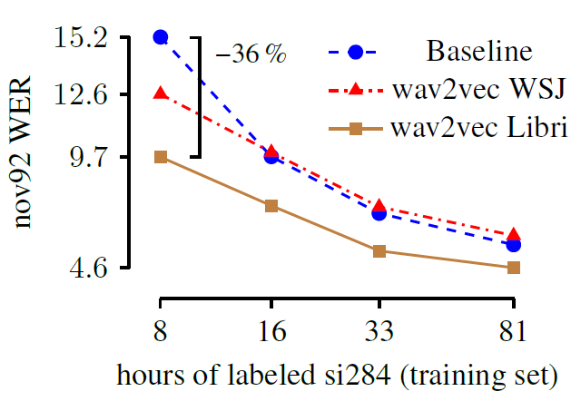

Slide 27
훈련
Wav2Vec은 Word2Vec처럼 해당 입력이 positive 쌍인지 negative 쌍인지 이진 분류(binary classification)하는 과정에서 학습. Positive 쌍은 그림1처럼 입력 음성의 i 번째 context representation ( Ci) 와 i+1 번째 hidden representation (Zi+1). 네거티브 쌍은 입력 음성의 i 번째 context representation Ci 와 현재 배치의 다른 음성의 hidden representation들 가운데 랜덤으로 추출한 것.
학습이 진행될 수록 포지티브 쌍 관계의 representation은 벡터 공간에서 가까워지고, 네거티브 쌍은 멀어진다. 다시 말해 encoder network f 와 context network g 는 입력 음성의 다음 시퀀스가 무엇일지에 관한 정보를 음성 피처에 잘 녹여낼 수 있게 됩니다.

Slide 28
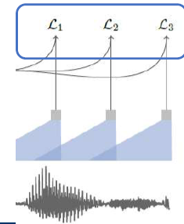
CPC objective function
미래의 z_{i+k} 와 상관관계가 높다면, L_{k}가 작아진다.
The correlation with negative examples
Select 10 randomly from each data

Slide 29
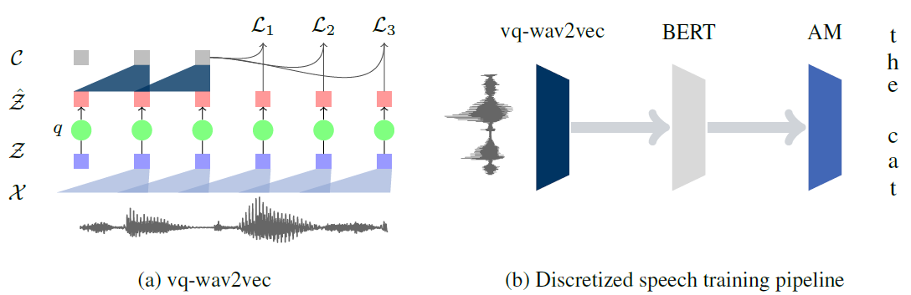
논문 3: VQ-WAV2VEC: SELF-SUPERVISED LEARNING OF DISCRETE SPEECH REPRESENTATIONS
저자：Alexei Baevski, Steffen Schneider, Michael Auli (Facebook)
양자화(Quantization) 한 후에 BERT의 방법을 이용
wav2vec embedding을 양자화
양자화된 embedding을 BERT 의 입력으로 넣어서 특징을 추출

Slide 30
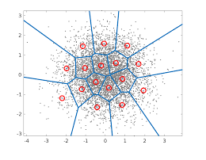
Vector quantization (<-> scalar quantization)
It works by dividing a large set of points (vectors) into groups having approximately the same number of points closest to them. Each group is represented by its centroid point, as in k-means and some other clustering algorithms.
2-D vector quantization 의 예

Slide 31
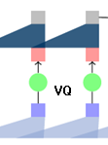
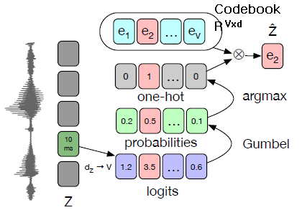
Embedding의 양자화
Using Gumbel softmax or K-means Gumbel softmax

Slide 32
Vector Quantization 모듈.
우선 Z 를 선형변환해 logit를 만들고, 여기에 Gumbel Softmax와 argmax를 취해 one-hot 벡터를 만든다. 연속적인(continous) 변수 Z 가 이산(discrete) 변수로 변환됐습니다. 이것이 바로 Vector Quantization.
이후 Embedding matrix를 내적해 Z^ 를 만든다. 결과적으로는 Vector Quantization으로 V 개의 Embedding 가운데 e2 를 하나 선택.
G개의 그룹을 사용. 실험 시 G=2

Slide 33
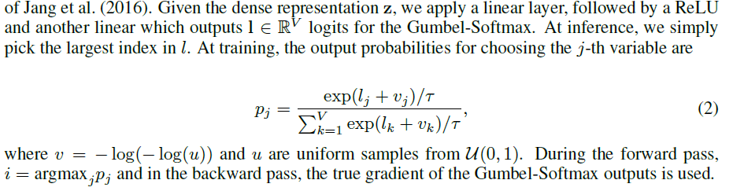
Gumbel softmax
Codebook 훈련의 문제 – 양자화 때문에 gradient 가 계산이 안되어서 codebook의 변수를 훈련할 수 없다.
Gumbel noise 를 섞으면 양자화 후의 분포가 일반 softmax 분포 비슷해진다.

Slide 34
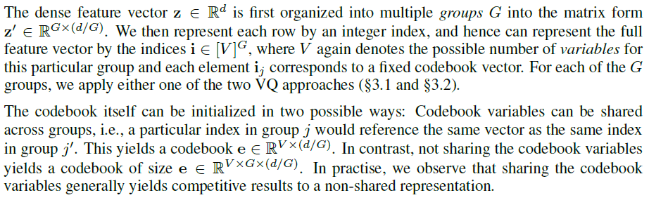
Gumbel-Softmax Models. We use G = 2 groups and V = 320 latents per group and the linear layer projects the features produced by the encoder into G V = 640 logits. The Gumbel-Softmax produces a one-hot vector for each group G. The temperature is linearly annealed from 2 to 0.5 over the first 70% of updates and then kept constant at 0.5. This enables the model to learn which latents work best for each input before committing to a single latent. After training this model on 960h of Librispeech and quantizing the training dataset, we are left with 13.5k unique codewords combinations (out of V G = 102k possible codewords).

Slide 35
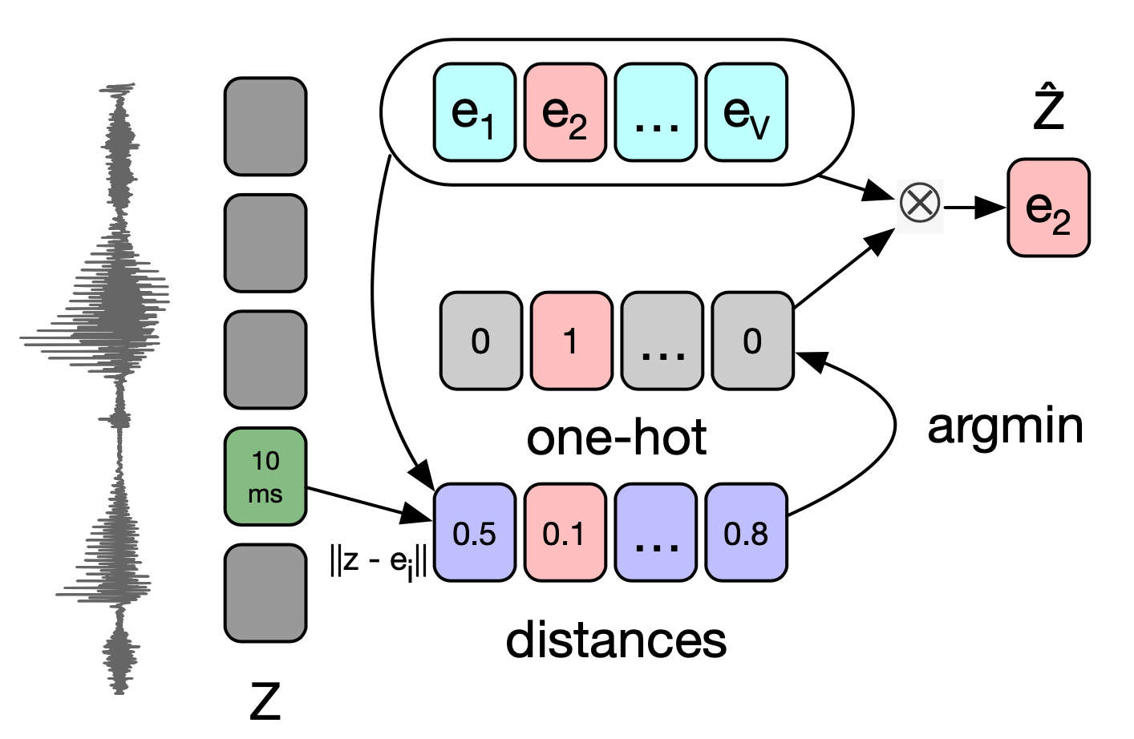
K-means clustering

Slide 36
Use of BERT
BERT is learned by masked token prediction. However, it is too easy to estimate the embedding of 10ms if you do it normally, so set the starting point with a probability of p = 0.05 and set 10 frames from there. Mask.

Slide 37
음성인식에의 이용
BERT의 출력을 음성인식의 feature-vector 에 이용
BERT small 을 이용한 실험 (BERT large 너무 크다)

Slide 38
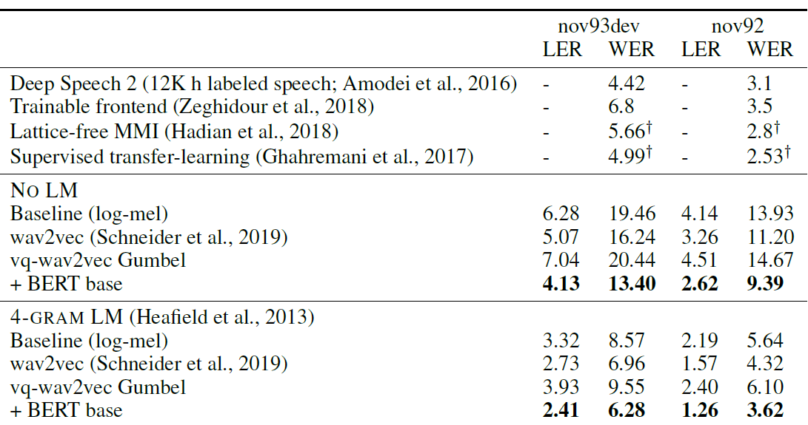
성능비교 (WSJ corpus)
Quantization에 의한 성능 하락을 BERT를 이용 복구.

Slide 39
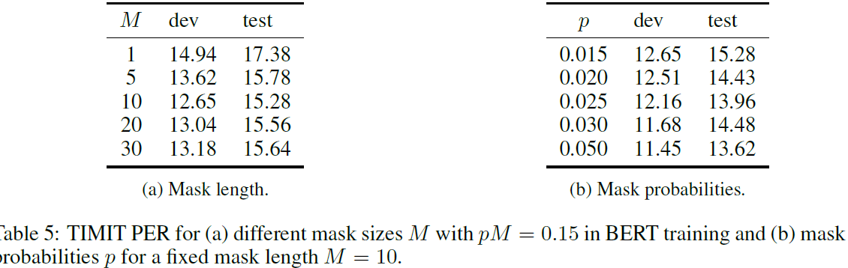
BERT mask length and probabilities for TIMIT training

Slide 40
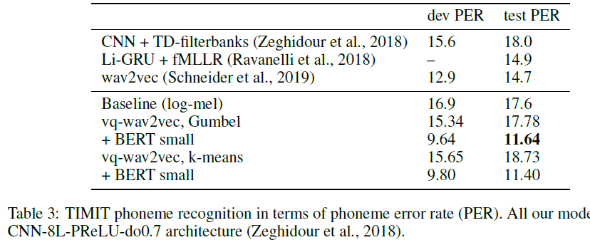

Slide 41
논문 4: Wav2vec 2.0
Transformer-based
Design ASR with only 10 minutes of labeled data (low resource speech recognition) and pre-training on 53K hours of unlabeled data (5.7/10.1 WER on clean/noisy Librispeech testset)

Slide 42
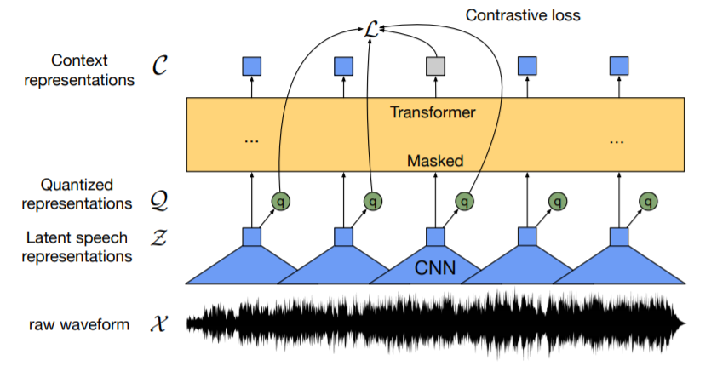
Vq-wav2vec 과 비교할 때 많이 간단해짐.
Context network이 생략되고, quantized latent representation 이 직접 Transformer 로 들어 감 (Transformer 가 context network 역할 도 함).
Previous work learned a quantization of the data followed by a contextualized representations with a self-attention model [5, 4], whereas our approach solves both problems end-to-end.

Slide 43
Feature encoder and Transformer
Feature encoder. The encoder consists of several blocks containing a temporal convolution followed by layer normalization [1] and a GELU activation function [21]. The raw waveform input to the encoder is normalized to zero mean and unit variance.
Contextualized representations with Transformers. The output of the feature encoder is fed to a context network which follows the Transformer architecture [55, 9, 33]. Instead of fixed positional embeddings which encode absolute positional information, we use a convolutional layer similar to [37, 4, 57] which acts as relative positional embedding.

Slide 44
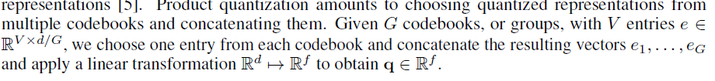
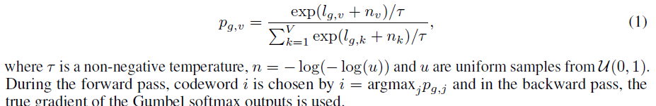
Quantization
Multiple codebooks and concatenate the results
Gumbel softmax for choosing discrete codebook entries in a differentiable way.

Slide 45
Training
To mask the latent speech representations output by the encoder, we randomly sample without replacement a certain proportion p of all time steps to be starting indices and then mask the subsequent M consecutive time steps from every sampled index; spans may overlap.

Slide 46

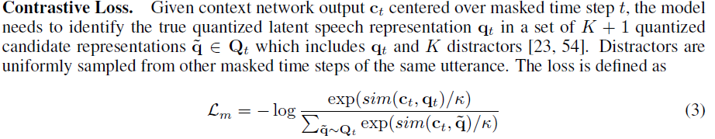

Training loss
Contrastive loss for masking and diversity loss for codebook entry diversity.

Slide 47

Contrastive loss
Given context network output c_{t} centered over masked time step t, the model needs to identify the true quantized latent speech representation qt in a set of K+1 quantized candidate representations q~ =Q_{t} which includes qt and K distractors. Distractors are uniformly sampled from other masked time steps of the same utterance. The loss is defined as:
where we compute the cosine similarity sim(a, b) = a^{T}b/||a||||b||
c_{t} 는 가급적 q_{t} 에 가깝게, 그렇지만 다른 것 과는 멀게

Slide 48
Diversity loss and Penalty
We encourage the equal use of the V entries in each of the G codebooks by maximizing the entropy of the averaged softmax distribution L over the codebook entries for each codebook p-g across a batch of utterances; the softmax distribution does not contain the gumbel noise nor a temperature.
To stabilize the training, it is helpful to apply an L2 penalty to the activations of the final layer of the feature encoder but before the final layer normalization.

Slide 49
Pretraining
For masking, we sample p = 0.065 of all time-steps to be starting indices and mask the subsequent M = 10 time-steps. This results in approximately 49% of all time steps to be masked with a mean span length of 14.7, or 299ms

Slide 50
Fine-tuning
Phoneme recognition task: adding a randomly initialized linear projection on top of the context network into C classes representing the vocabulary of the task [4].
Grapheme output - for Librispeech, we have 29 tokens for character targets plus a word boundary token. Models are optimized by minimizing a CTC loss [14] and we apply a modified version of SpecAugment [41] by masking to time-steps and channels during training

Slide 51
Datasets
Unlabeled dataset for pretraining: Librispeech corpus [40] without transcriptions containing 960 hours of audio (LS-960) or the audio data from LibriVox (LV-60k).
Finetuning – TIMIT and Librispeech

Slide 52
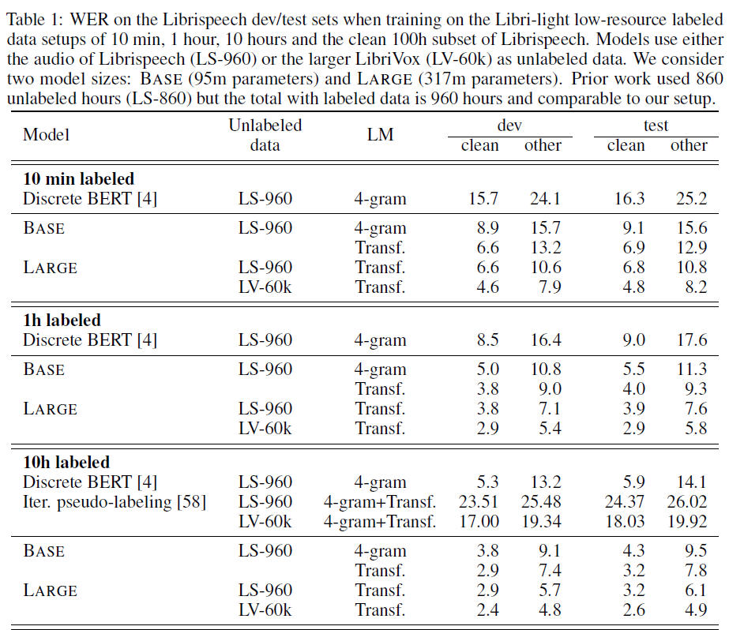

Slide 53
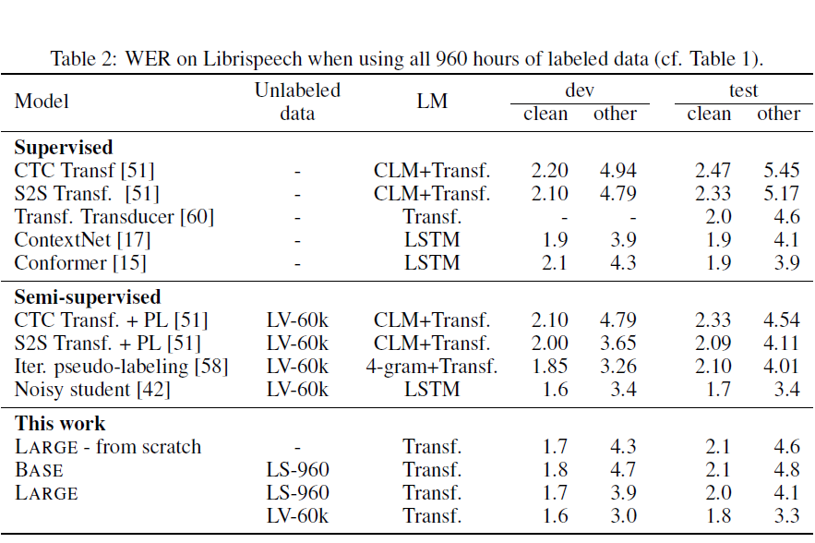

Slide 54
결론
NLP에서 많이 이용되는 pre-training 방법을 응용
Wav2vec – unlabeled data를 활용하여 pre-training 후 소량의 labeled data로 좋은 음성인식기 설계
Vq-wav2vec – BERT 모델을 이용하여 성능을 높였다.
Wav2vec 2.0 – VQ-wav2vec 을 간략화시켜서 context network 과 BERT 를 Transformer 구조로 대치하였다.

